Slide 1
ECE411 Practicum Project Presentation Team#14
Kam Robertson
Kyle Johnson
Saly Hakkoum
Brian Dunn
December 7, 2016
Revision 2.0

Slide 2

Problem or Need
A pace setting device to standardize timing (typically musicians) that provides visual and auditory feedback.

Slide 3

Motivation
Kam: My motivation in this project is to use it as a skill building exercise in the functional construction of subsystems and the effective interaction of those subsystems inside a microcontroller
Kyle: Build something useful while meeting the requirements defined by management (Mark/Andrew).
Saly: My motivation is to get more involved in hardware design and the steps involved in the process of producing a system controlled by a microcontroller. Also taking a part in a real practicum group project.

Slide 4

Objective
Inexpensive solution to provide a pace setting device for a multitude of uses that incorporates an input mechanism to set the desired pace along with an output mechanism to confirm the desired pace.
Minimal instructions necessary beyond product description, easy to use such that a 5 year old human child can operate within 1 minute.

Slide 5

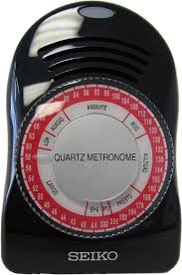
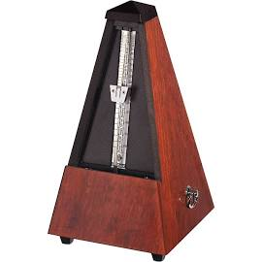
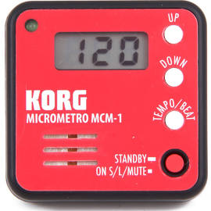
Alternatives
There are many alternatives available in the market today:
Examples from google “metronome” search:
Analog ($57), digital ($15).

Slide 6

Requirements
The practicum requirements include:
At least 1 sensor {3 (rotary encoder/toggle button, toggle switch)}
At least 1 actuator {3 (2x LED, 1x piezo)}
At least 1 digital or analog processor {1x PIC16F648A}
Has to be safe.
Schematic (EagleCAD)
PCB with at least 2 layers.
Components: at least 25% surface mount {33x smd (89%), 4x thd (11%)}
Assembled by hand, be tested, works.
Documentation (live, revision controlled, collaborative documentation tools)

Slide 7

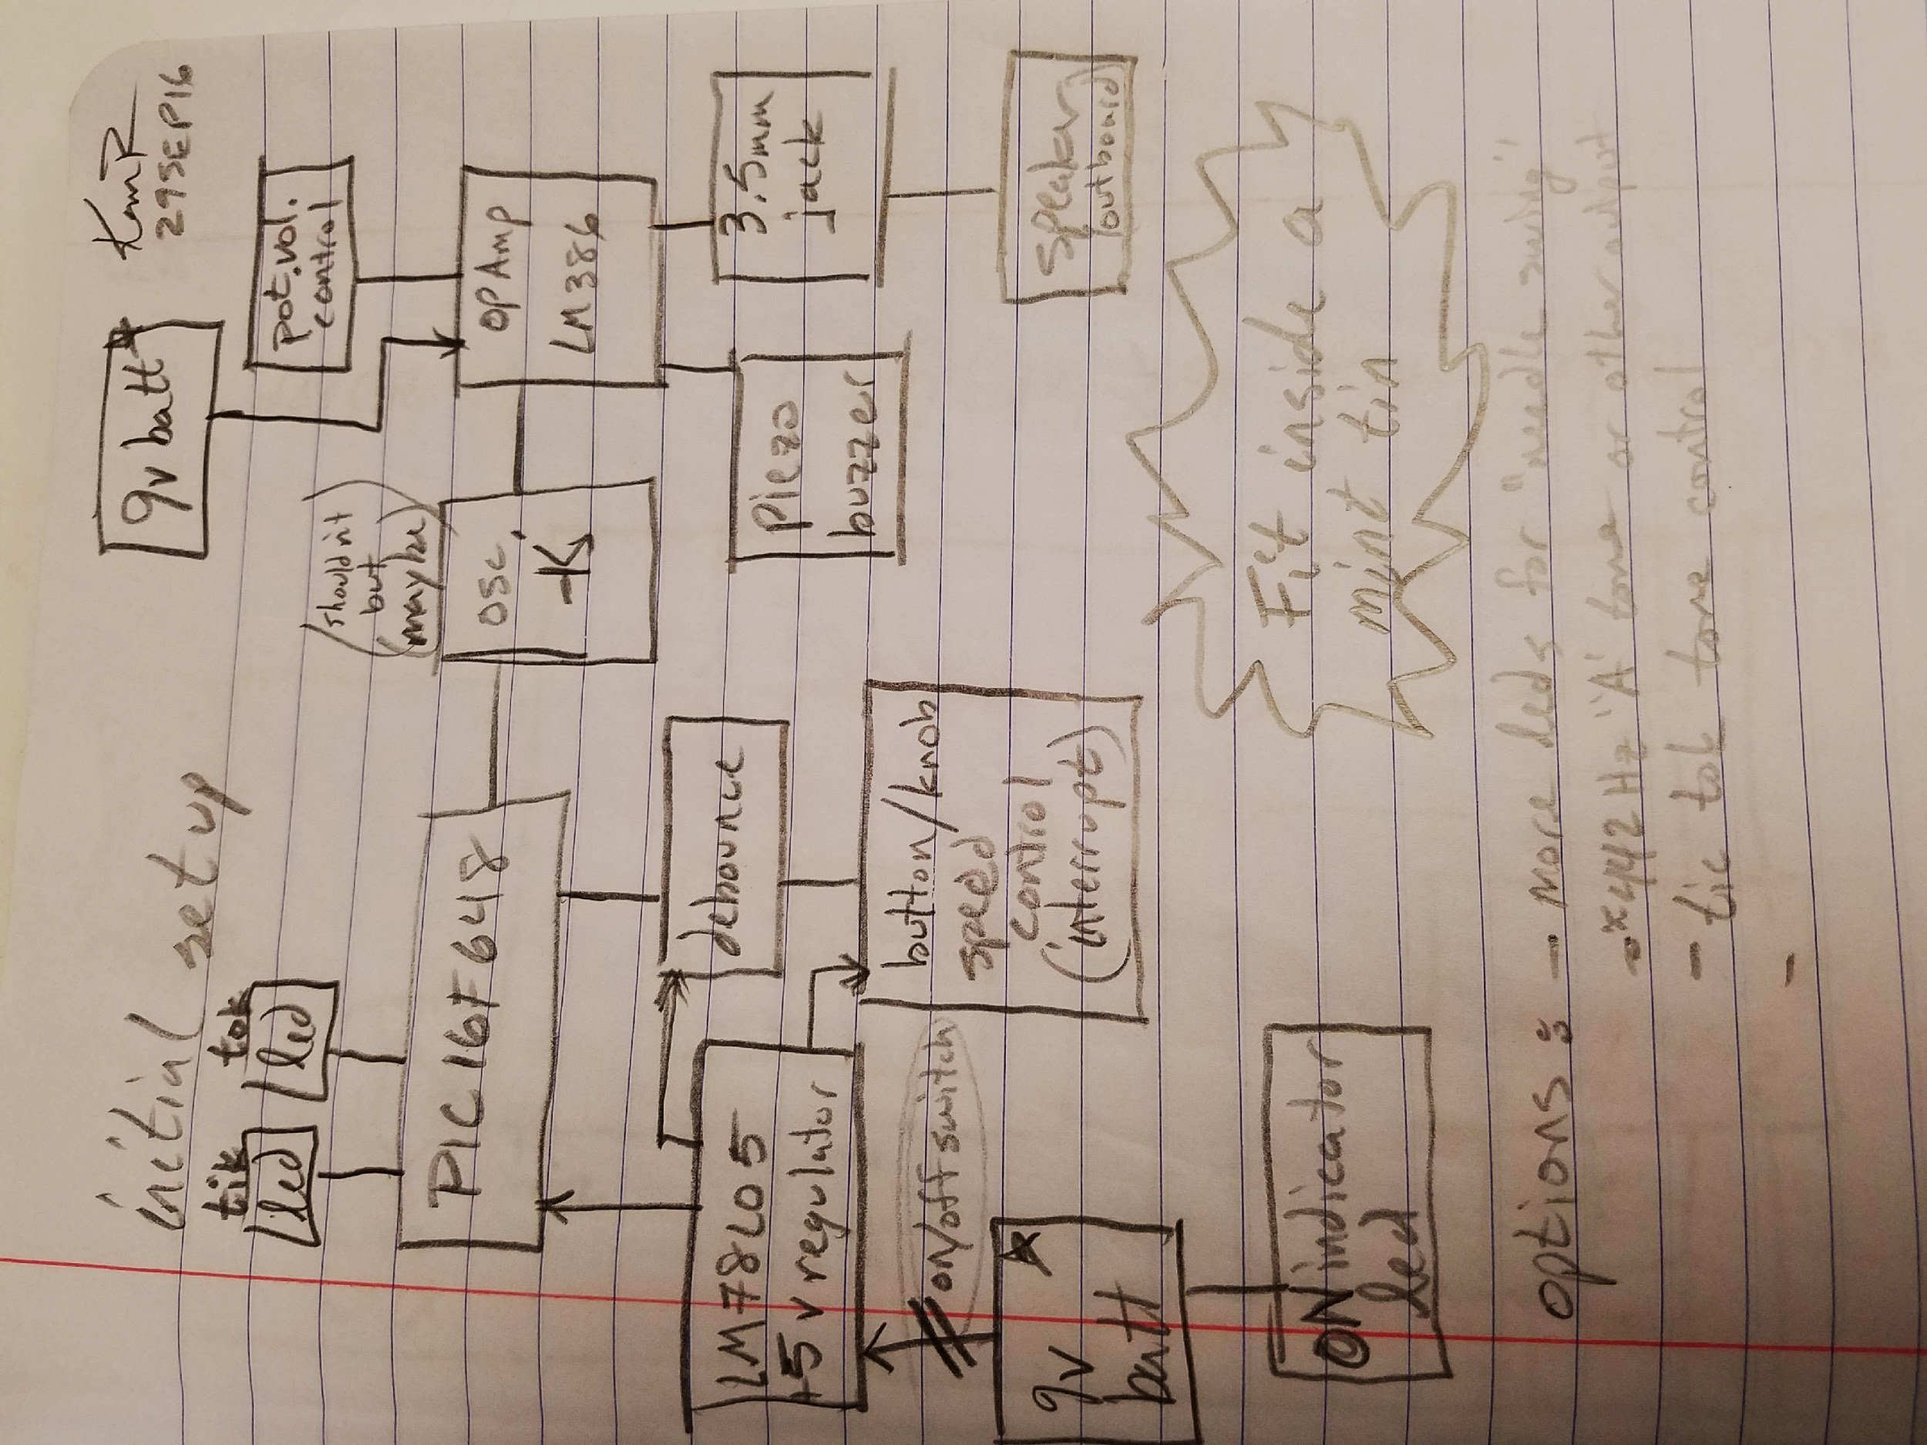
Design (initial concept)
Initial design review: Meets practicum specifications

Slide 8
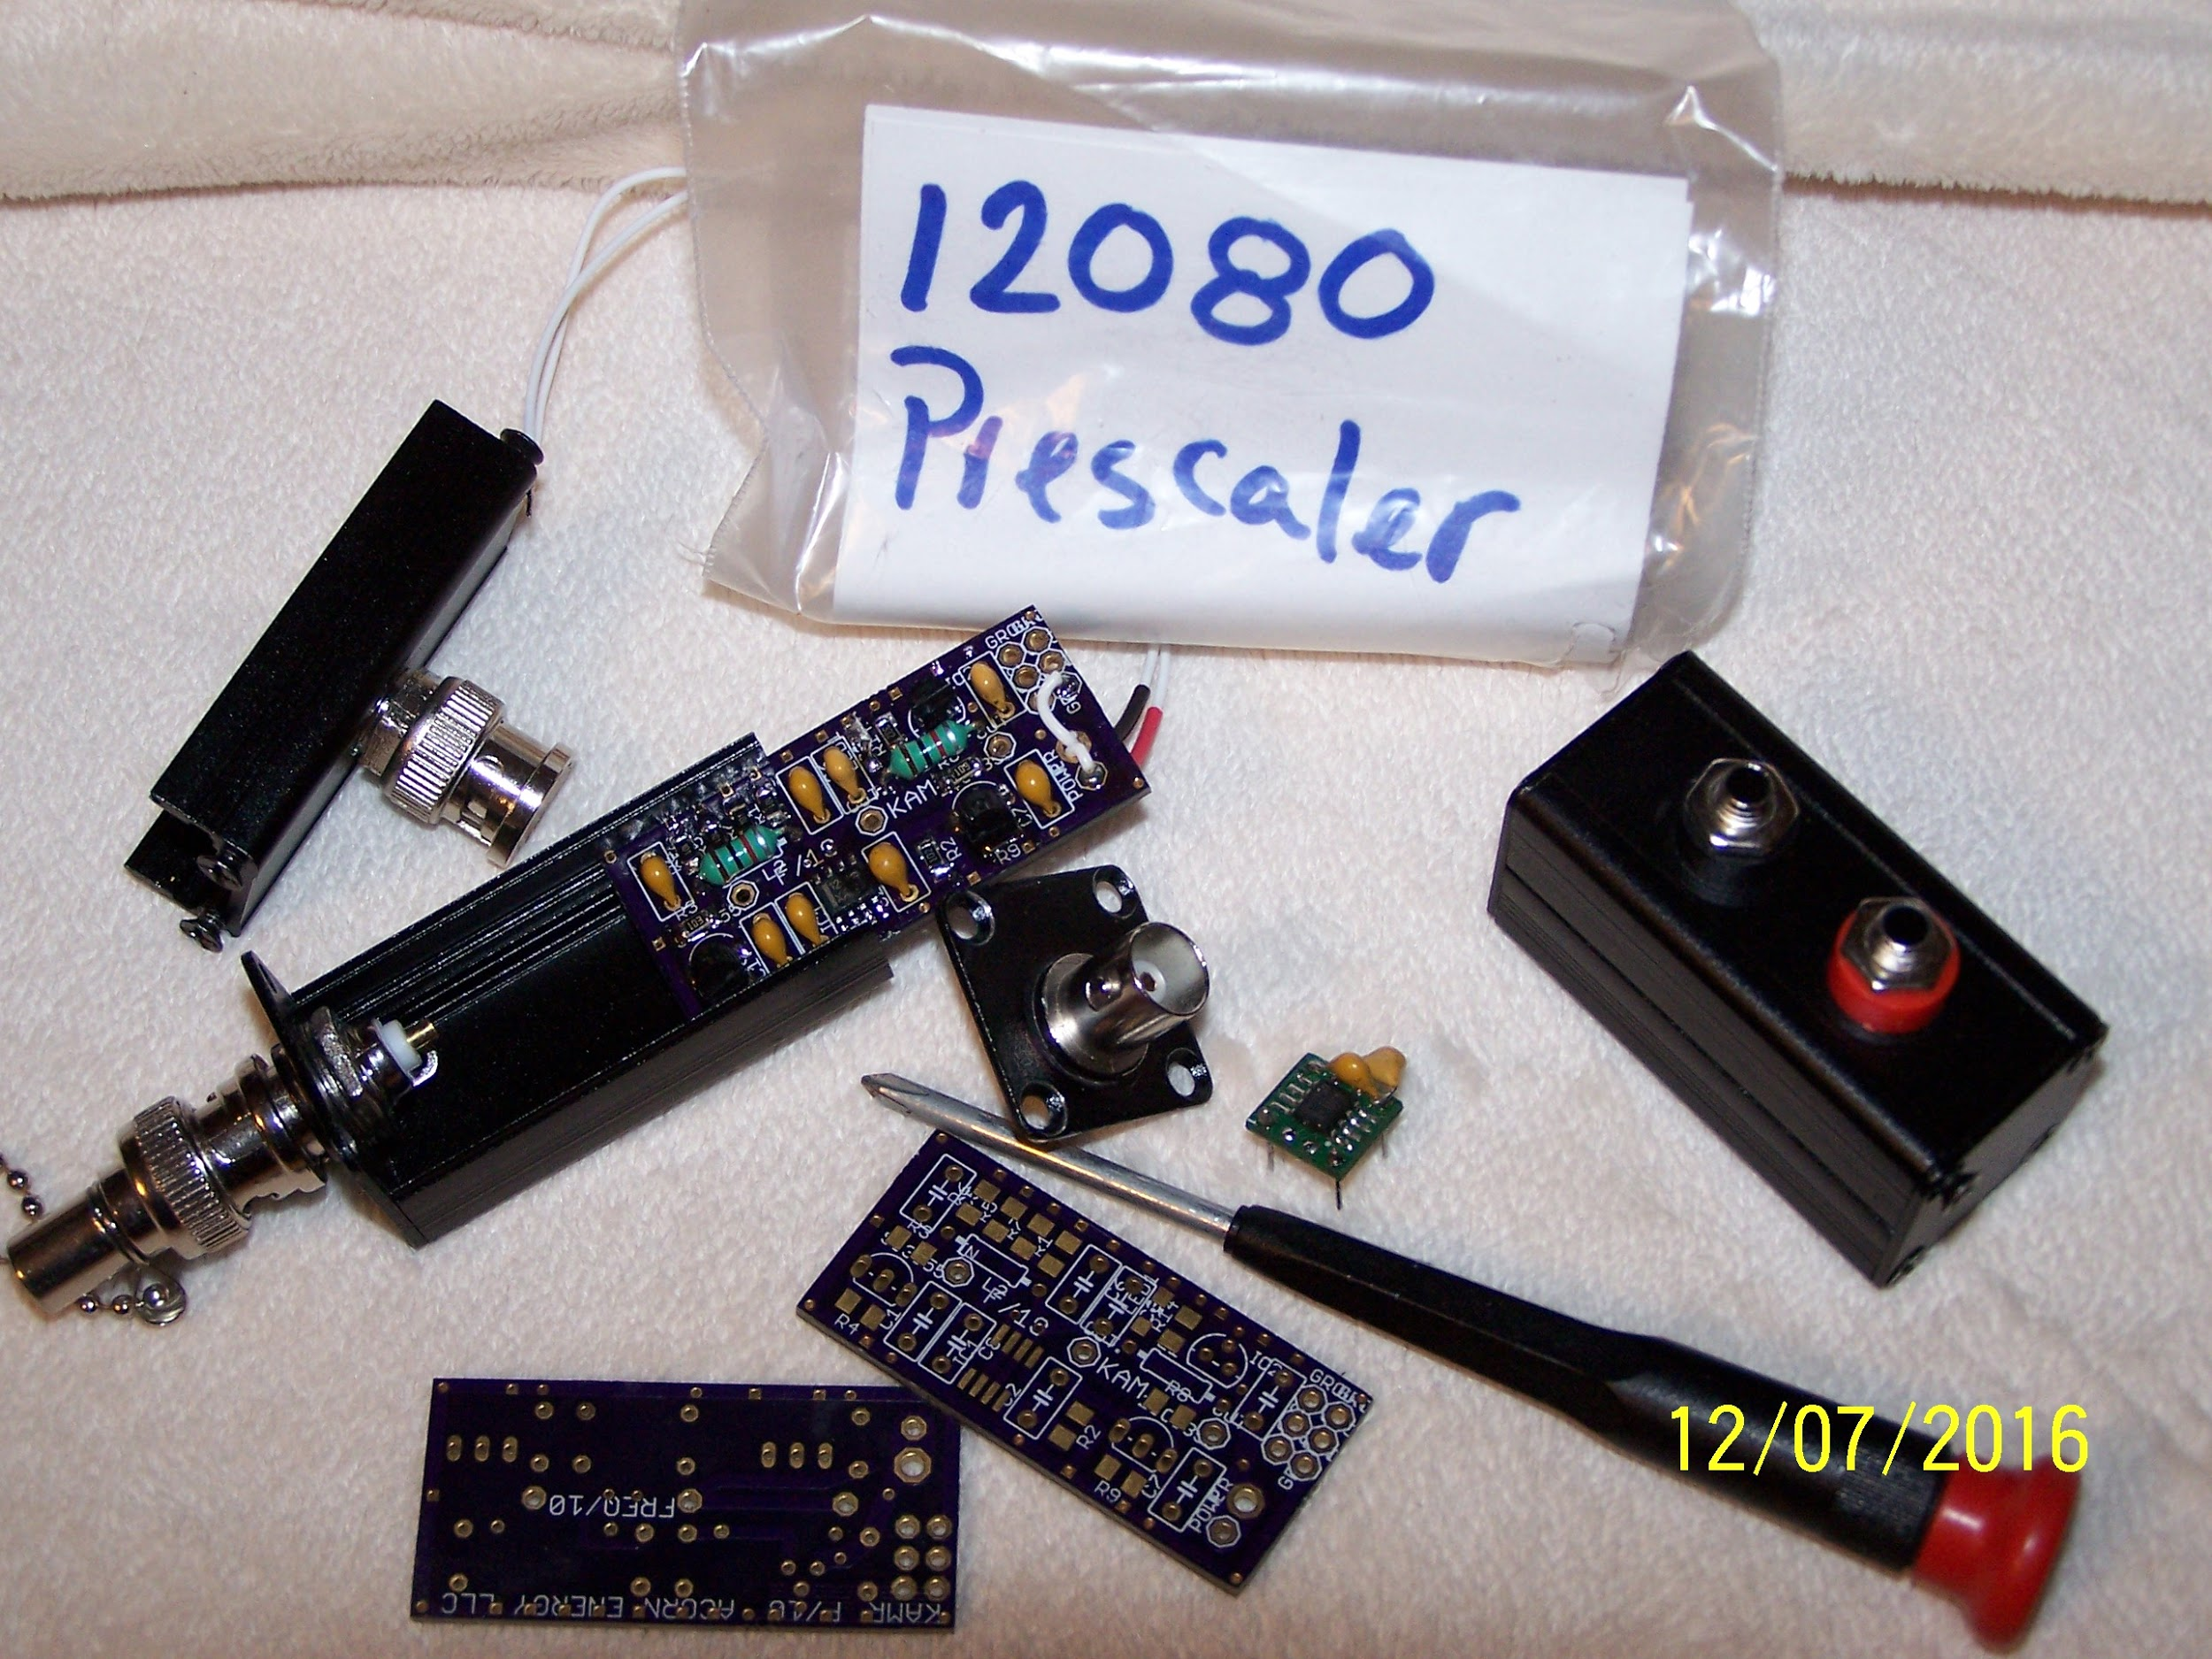
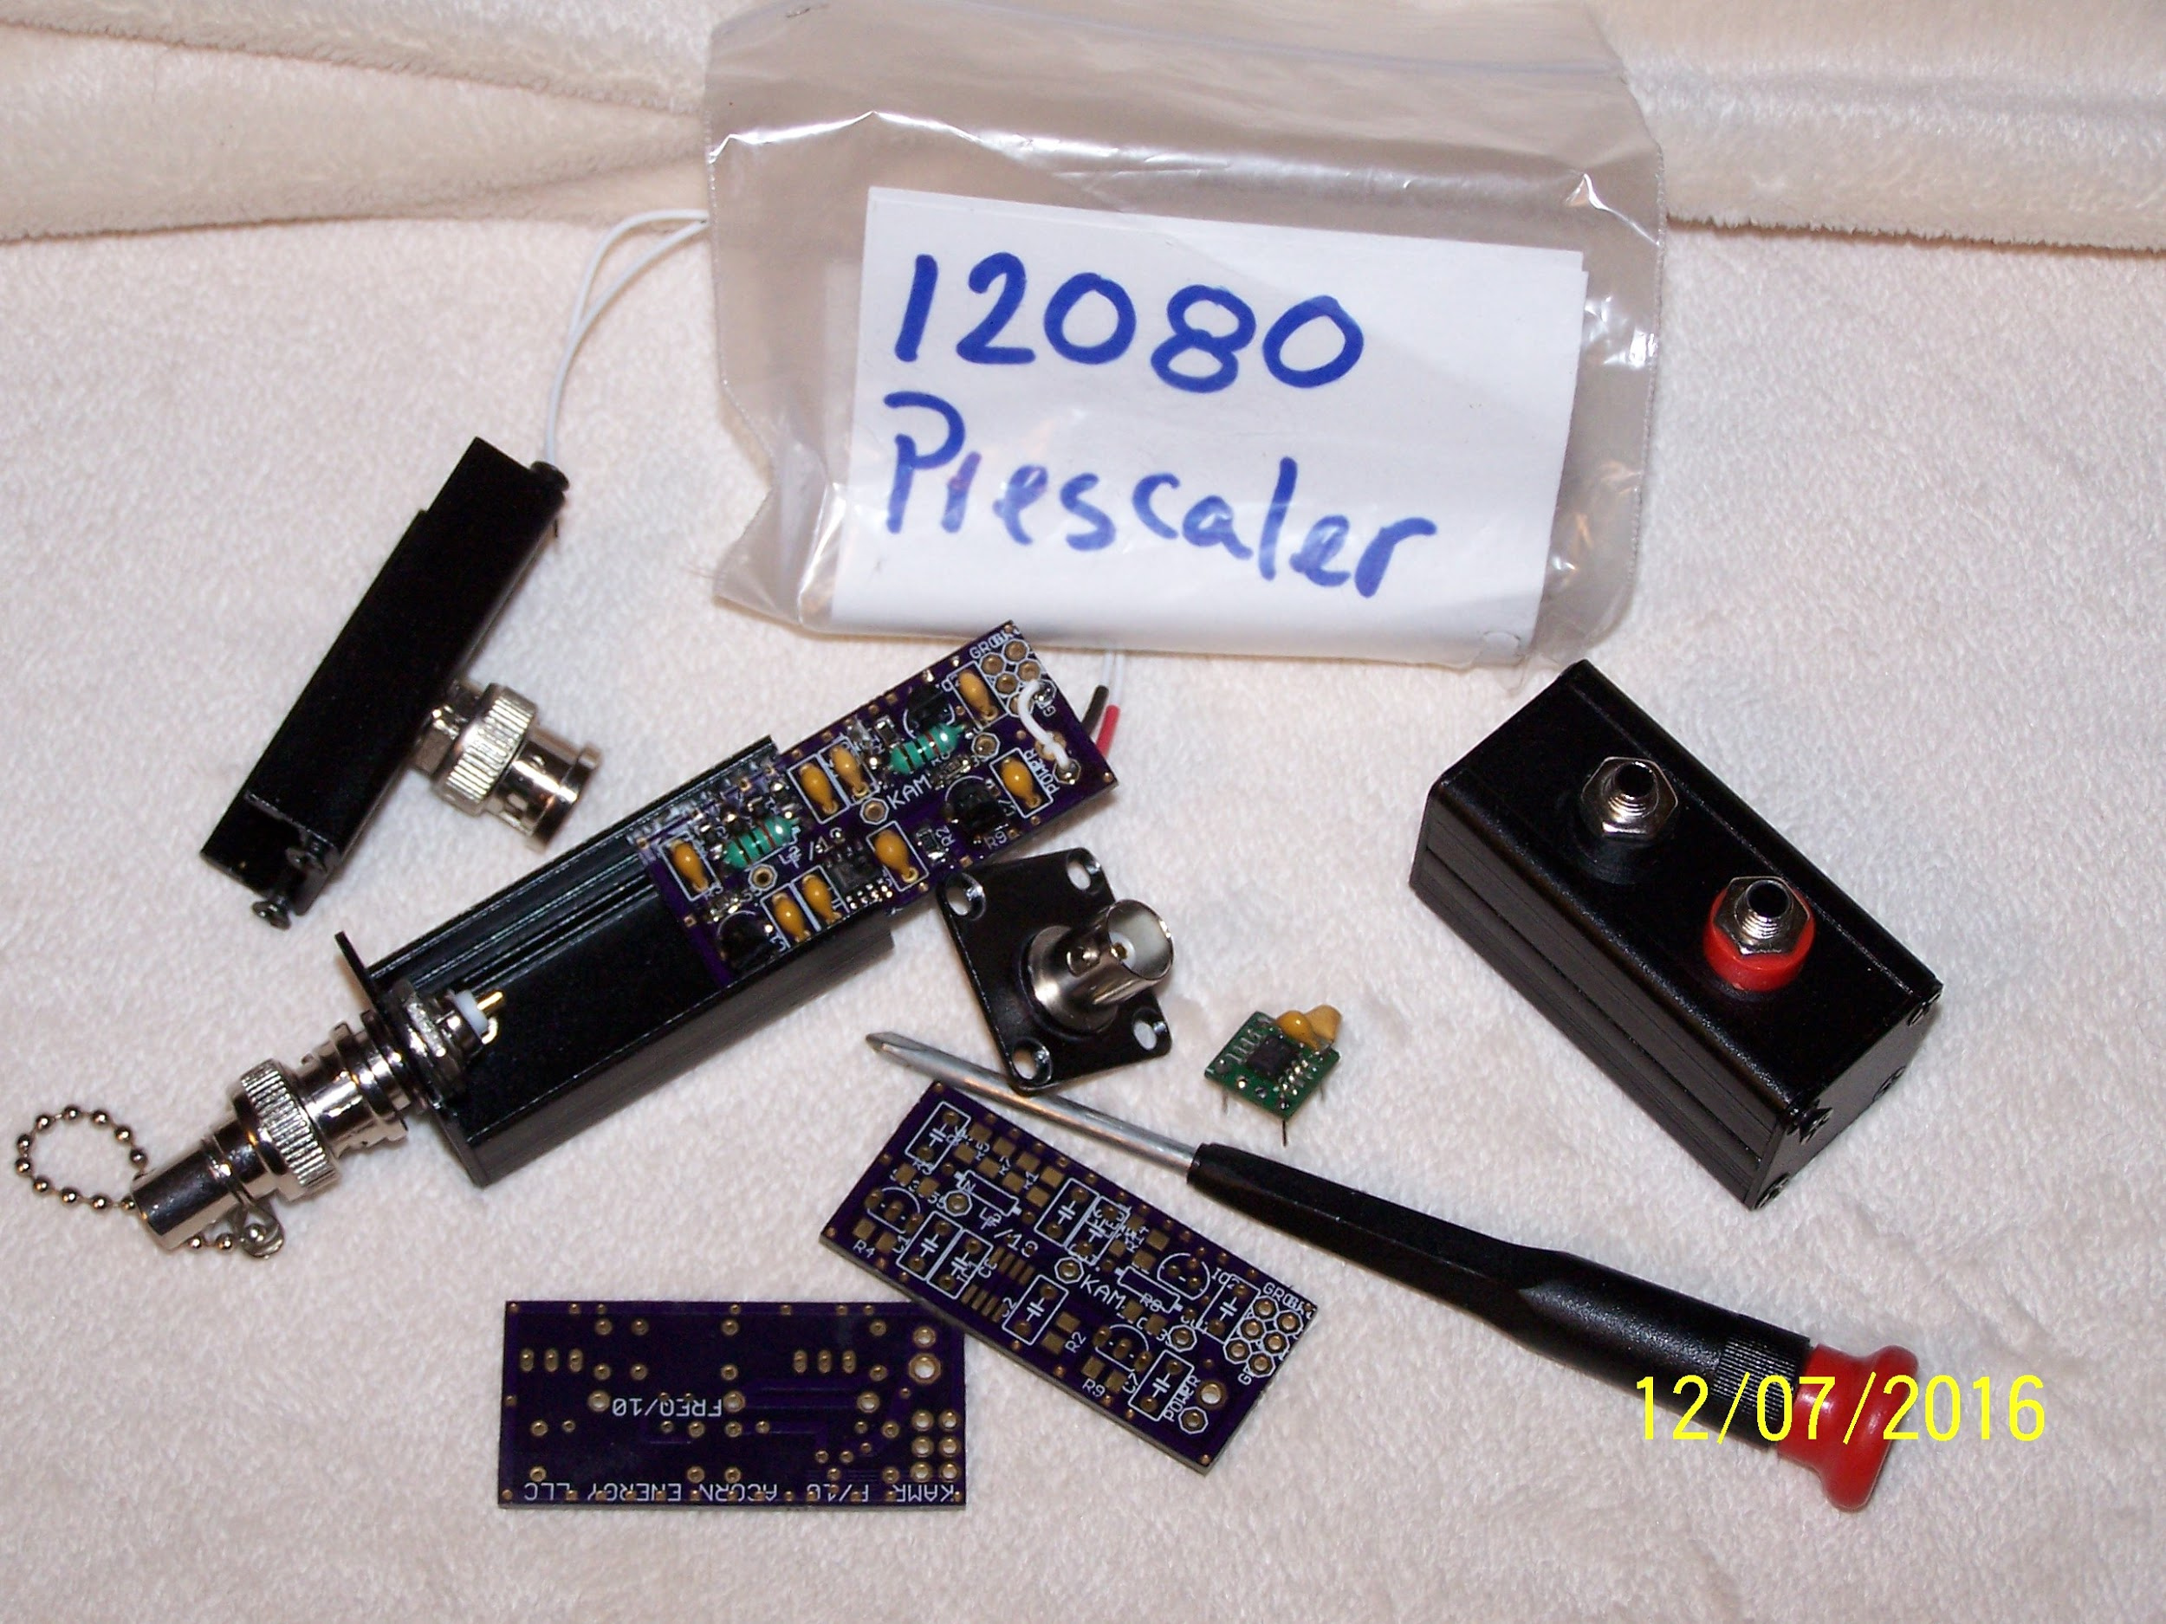
SCRAMBLE FOR A PCB TEST PROJECT

Slide 9

Approach (system clock)
A REAL TIME CLOCK MAKES SENSE FOR A METRONOME.
Let’s build one…. nope.
Let’s use a 32.768 kHz xtal and the low power selection on the microcontroller
Let’s use a rotary encoder to control the beats per minute.
interrupt driven button to control/change a mode/state, interrupt driven rotary encoder with microcontroller, effective dc power regulation and distribution
PCB design and build: EagleCAD has a long and steep learning curve.

Slide 10

Approach (system audio)
past experience shows that audio output from integrated circuits can be weak and and some specific amplification iis necessary for strong audio.
choose audio generator
Piezo buzzer is inexpensive, commonly available
choose opamp to drive the audio generator
LM386 is inexpensive, commonly, and task specific
choose the pin on the microcontroller
PWM is available. Let’s use it.
breadboard it, test, change as necessary, prototype, add to pcb schematic and board
Find out at the end that chip capacitors are just not the same
a piezo counts as the dc blocking cap.

Slide 11

Approach (system visual)
Modern leds are very efficient
led resistor values figuring the led to be a 5 mW device
5v 1kohm works well (bright)
indicator led’s may be considered to be 0.5mW devices
5v 10kohm works for most… (bright enough)

Slide 12

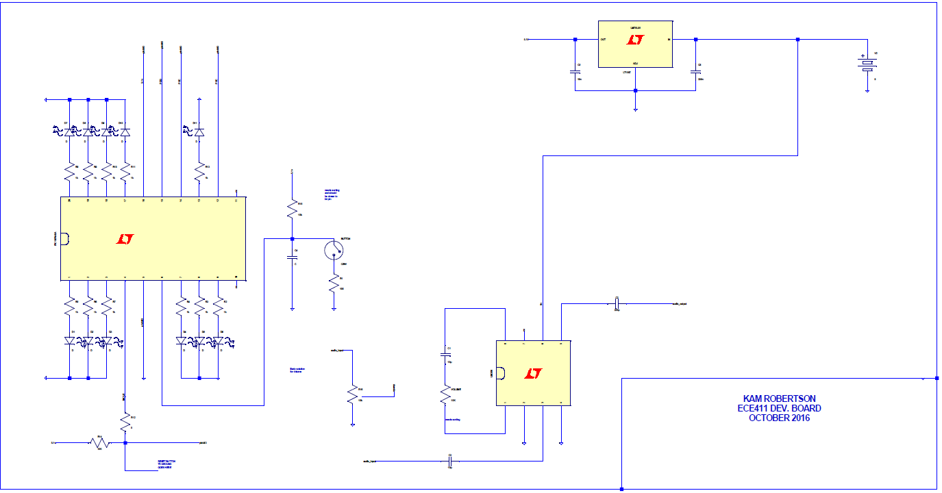
Design progress: Ltspice Schematic

Slide 13
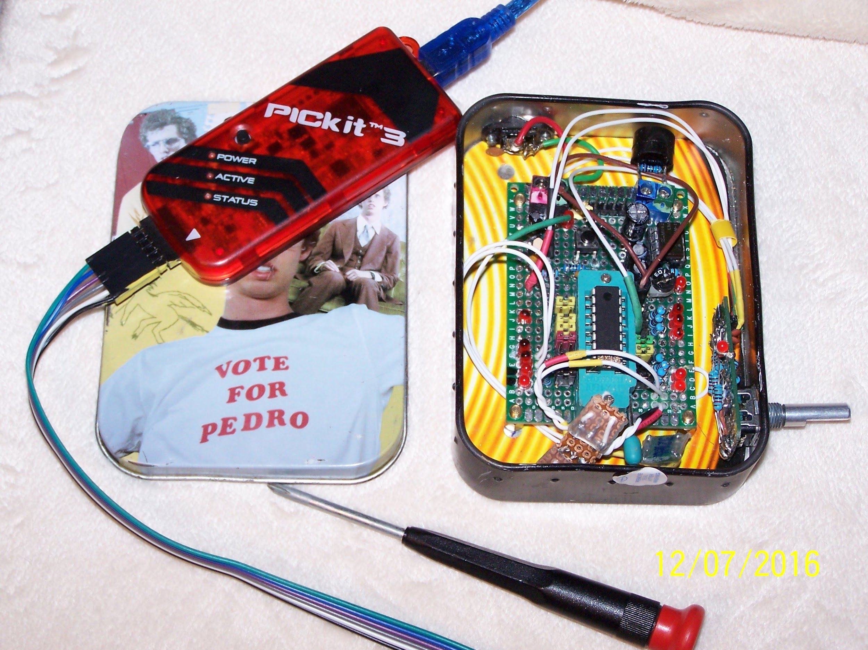
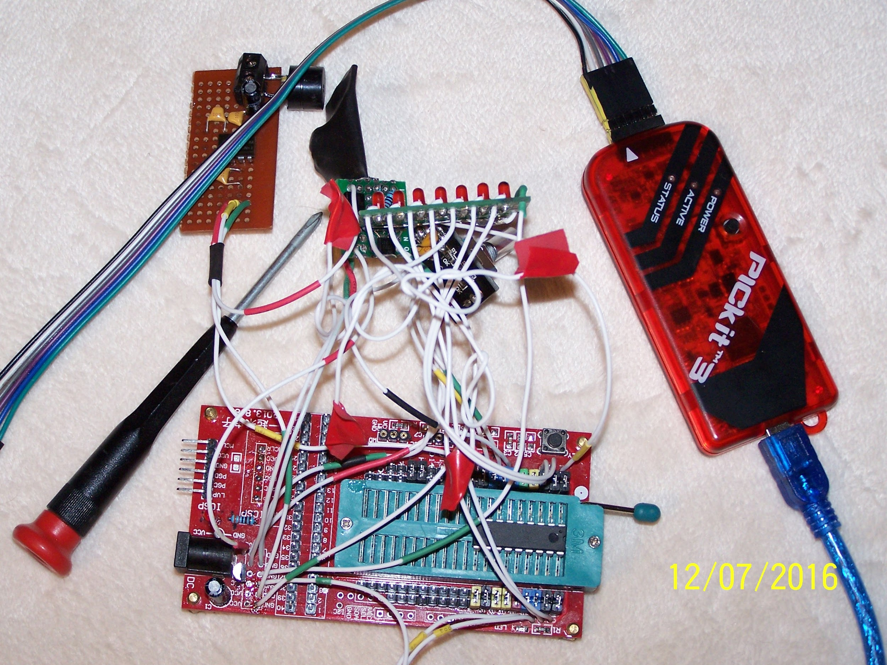
PROTOTYPE

Slide 14

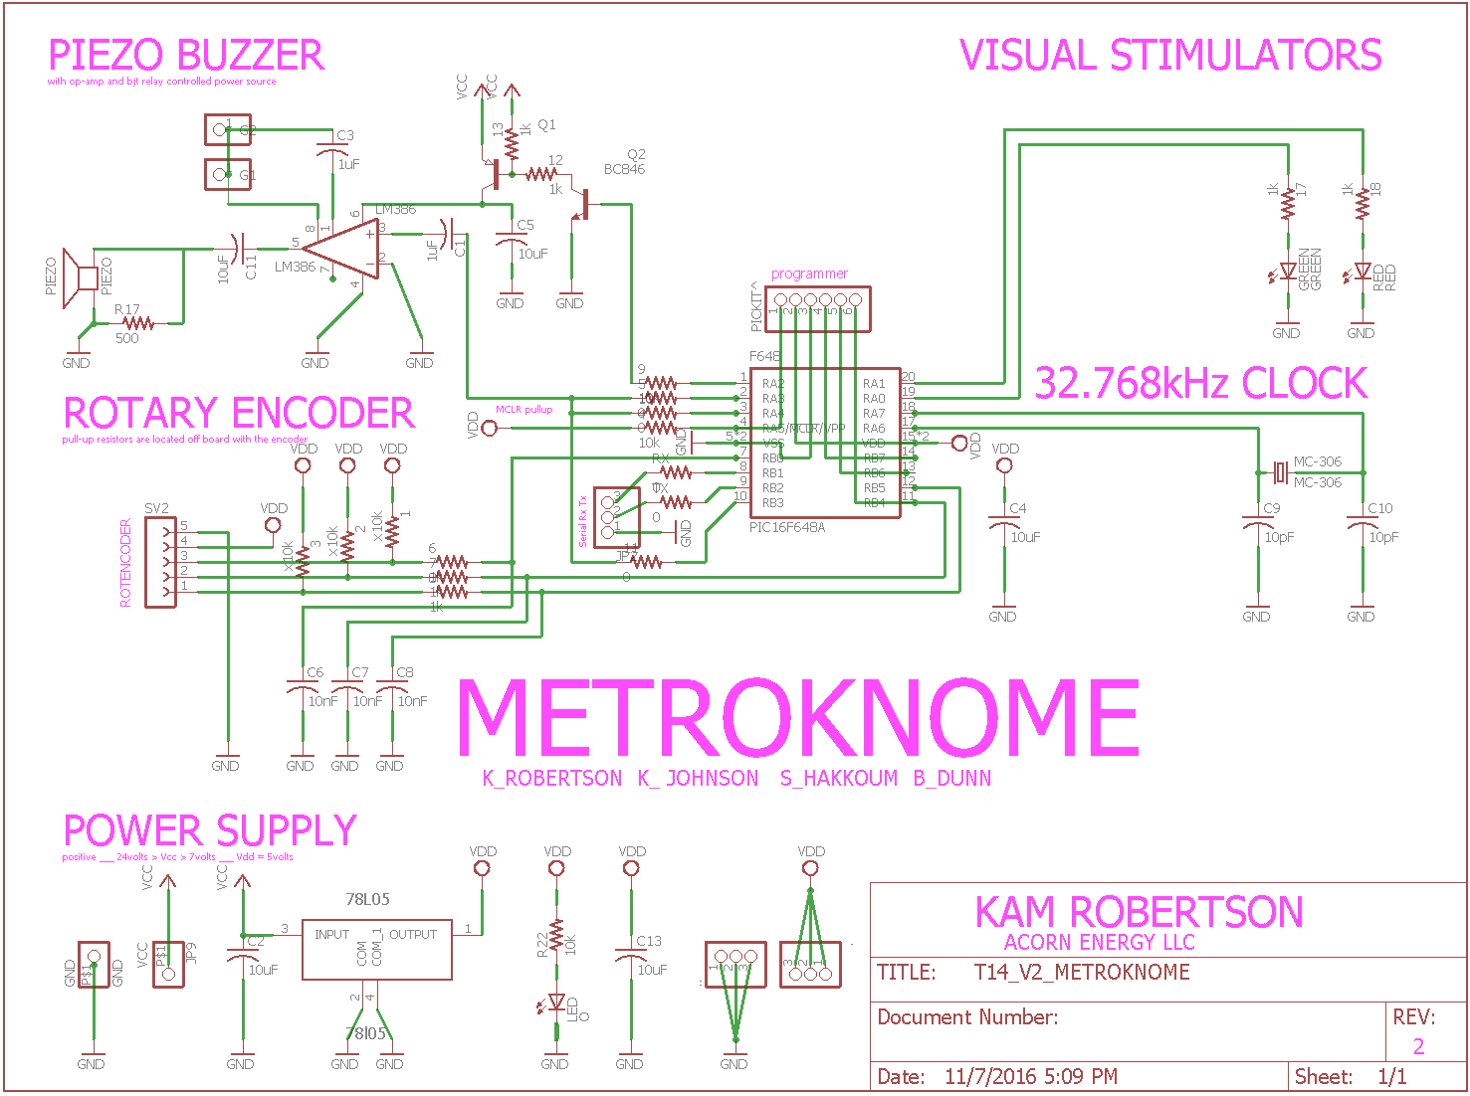
Implementation (schematic)

Slide 15

Implementation (BOM)
14 METROKNOME ECE411, TOTAL COST & BOM SHEET, KAM ROBERTSON, Nov-16
AMOUNT DESCRIPTION SOURCE UNITCOST TOTAL
1.00 extruded aluminum enclosure custom $6.93 $6.93
0.25 fab shop v2 board shop oshpark $13.20 $3.30
1.00 PIC16f648a ssop 20pin mouser $2.60 $2.60
1.00 0.5k 1206 resistor mouser $0.10 $0.10
3.00 10k 1206 resistor mouser $0.10 $0.30
7.00 1k 1206 resistor mouser $0.10 $0.70
1.00 100nF 1206 capacitor mouser $0.10 $0.10
2.00 10pf 1206 capacitor mouser $0.10 $0.20
4.00 10uf 1206 capacitor mouser $0.10 $0.40
2.00 1uf 1206 capacitor mouser $0.10 $0.20
3.00 10nf capacitor mouser $0.10 $0.30
1.00 lm386 soic mouser $0.85 $0.85
1.00 78l05 sot89 mouser $0.41 $0.41
AMOUNT DESCRIPTION SOURCE UNITCOST TOTAL
0.25 6 pin header mouser $2.29 $0.57
1.00 9 volt battery mouser $2.37 $2.37
1.00 9 volt battery clip mouser $0.36 $0.36
2.00 5mm thru hole led mouser $0.17 $0.34
1.00 piezo buzzer no int. osc. mouser $0.84 $0.84
1.00 1206 led mouser $0.17 $0.17
1.00 pec-11 w/switch and 24detent mouser $1.68 $1.68
1.00 on/off toggle switch mouser $2.25 $2.25
5.00 stranded teflon wire mouser $0.53 $2.65
1.00 mc-306 32.768 tuning fork xtal mouser $0.51 $0.51
1.00 pnp transistor sot89 mouser $0.39 $0.39
1.00 npn transistor sot23 mouser $0.10 $0.10
0.25 T14 PROTO DEV. BOARD custom $76.97 $19.24
0.25 fab shop v1 pcb oshpark $13.25 $3.31
0.25 parts for v1 pcb mouser $16.32 $4.08
COST PER PERSON $55.26

Slide 16
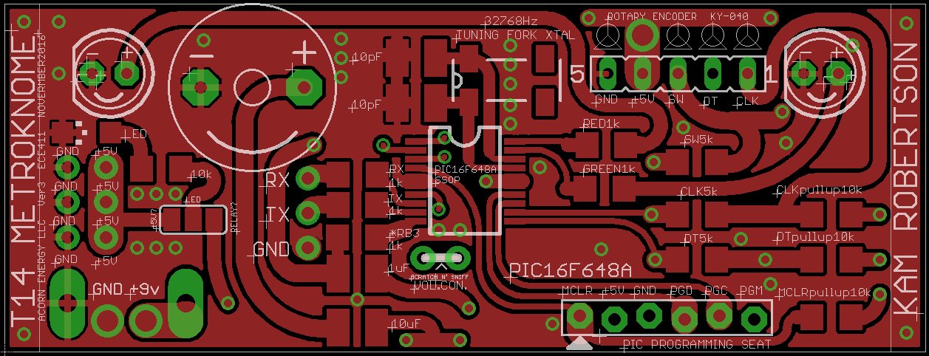
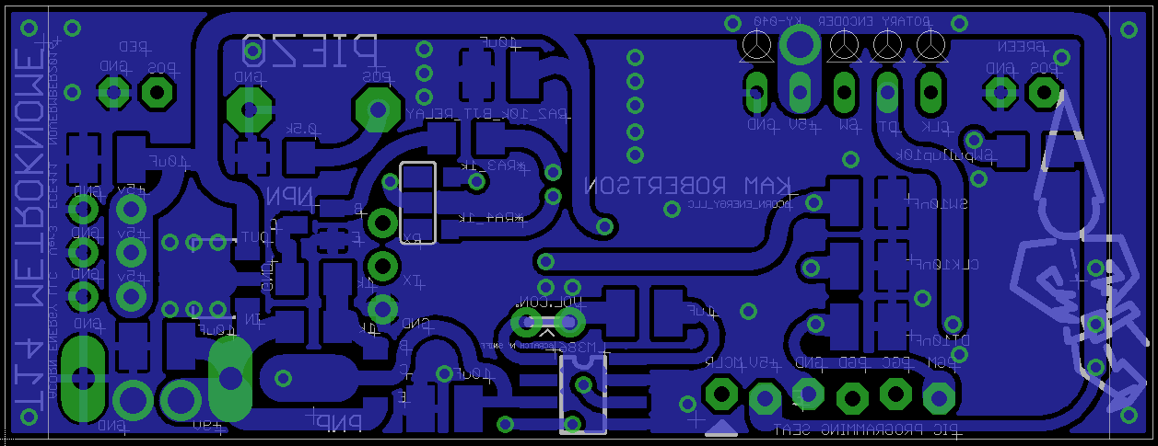
PCB

Slide 17
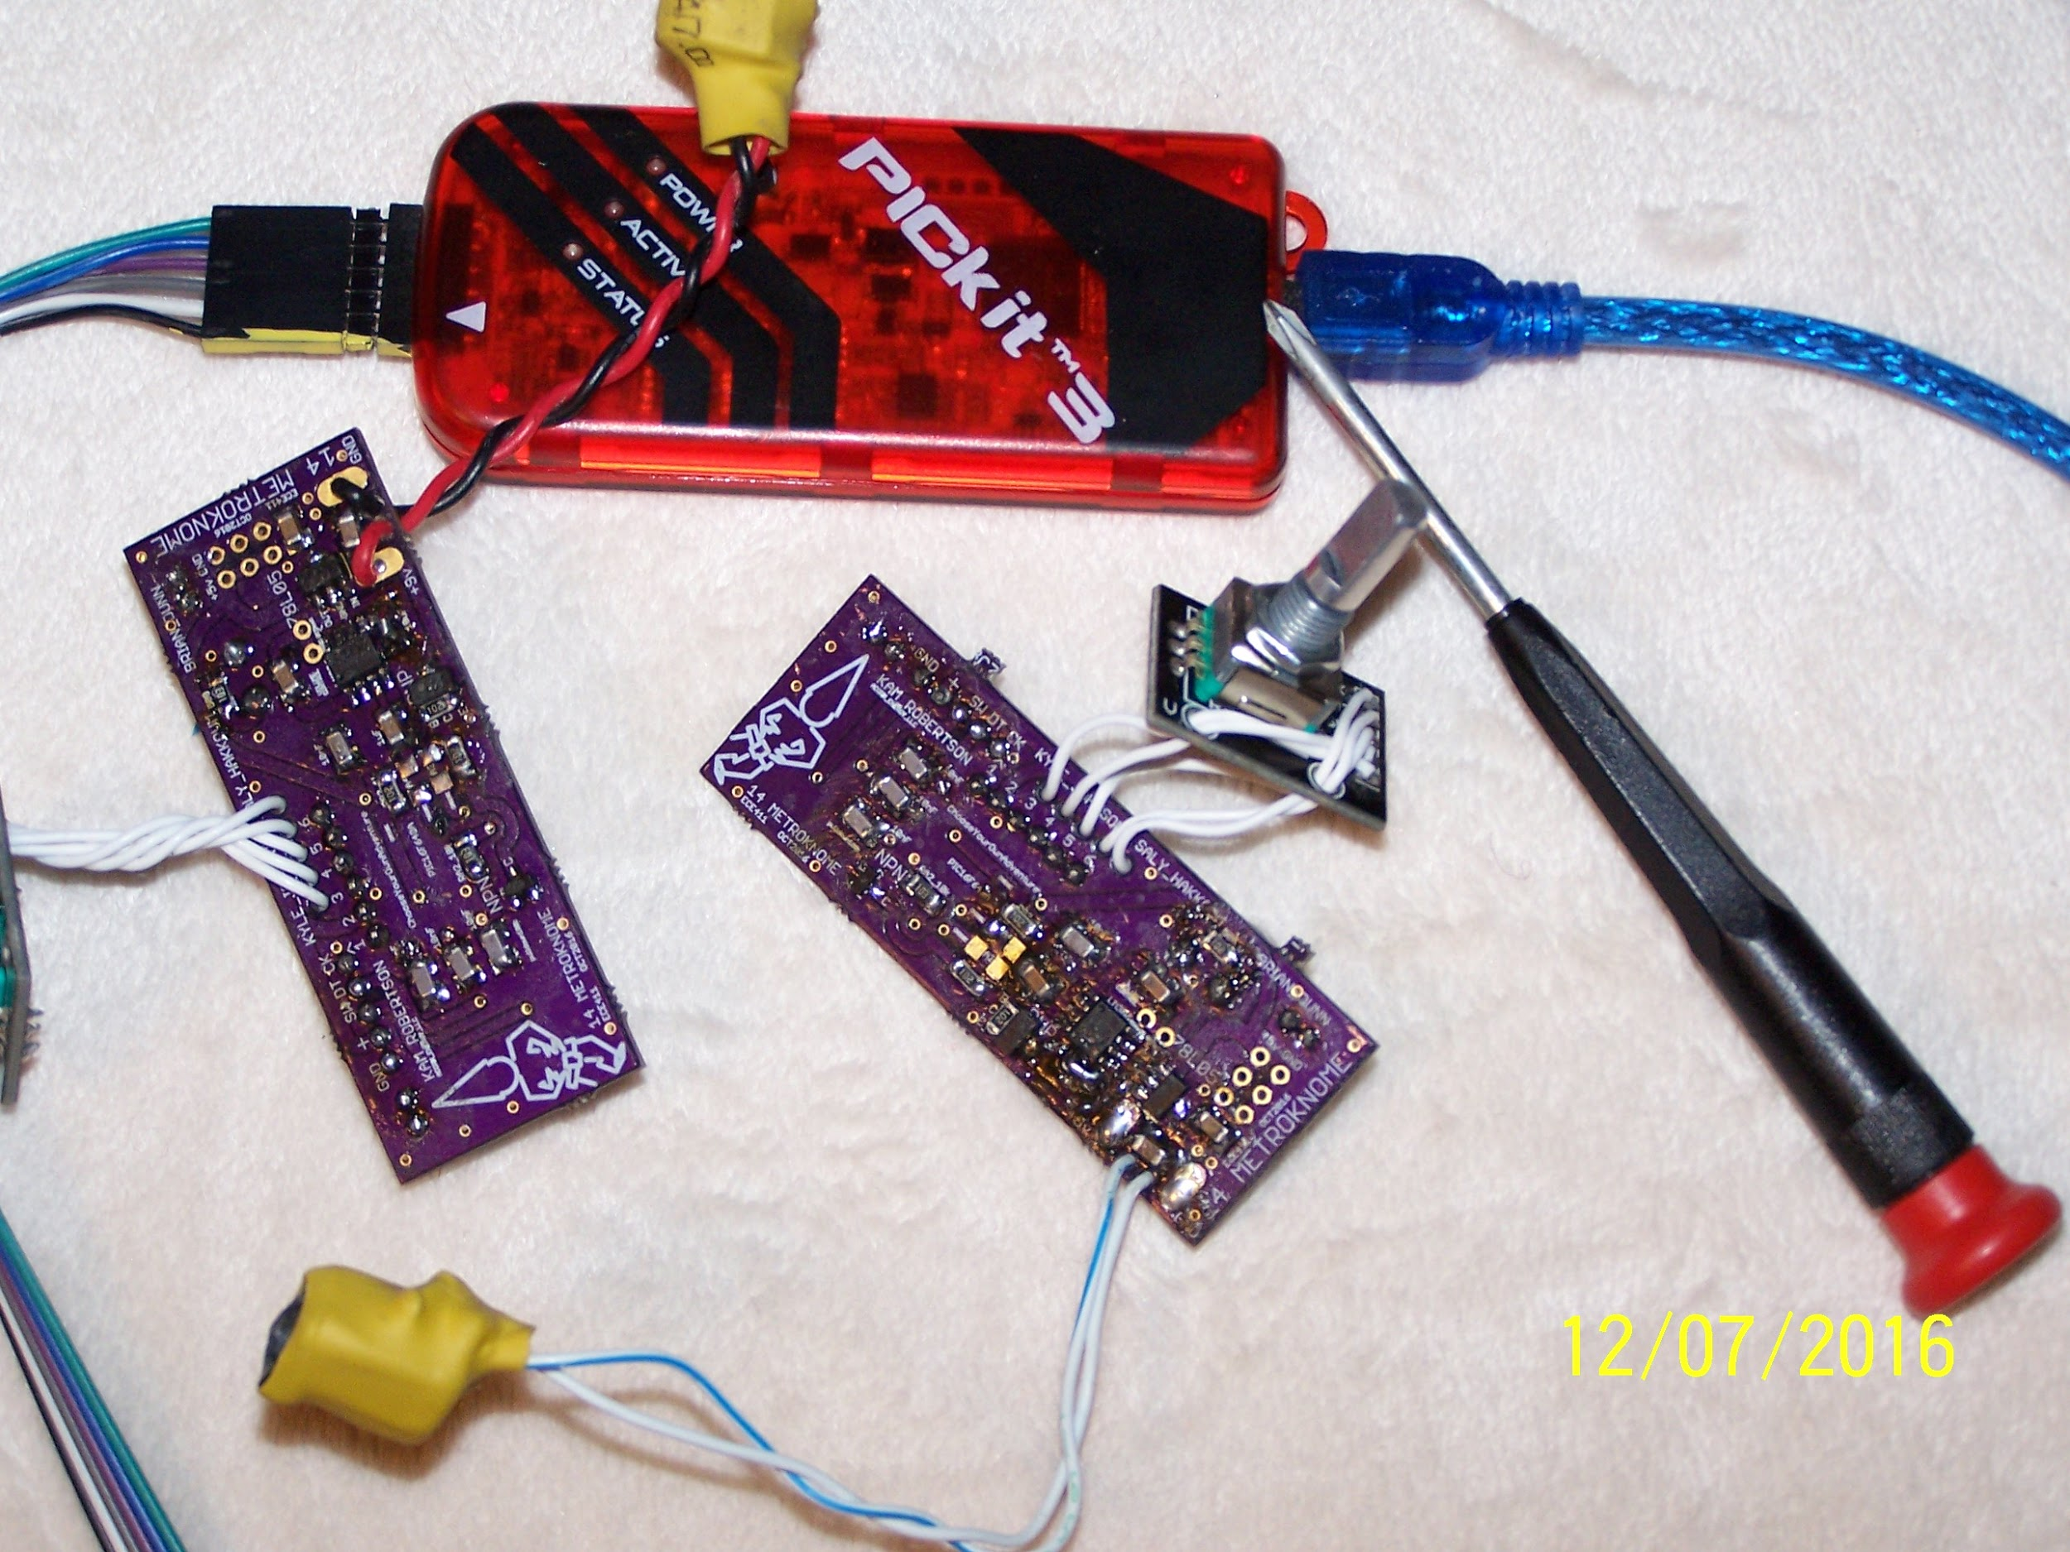
Version1

Slide 18

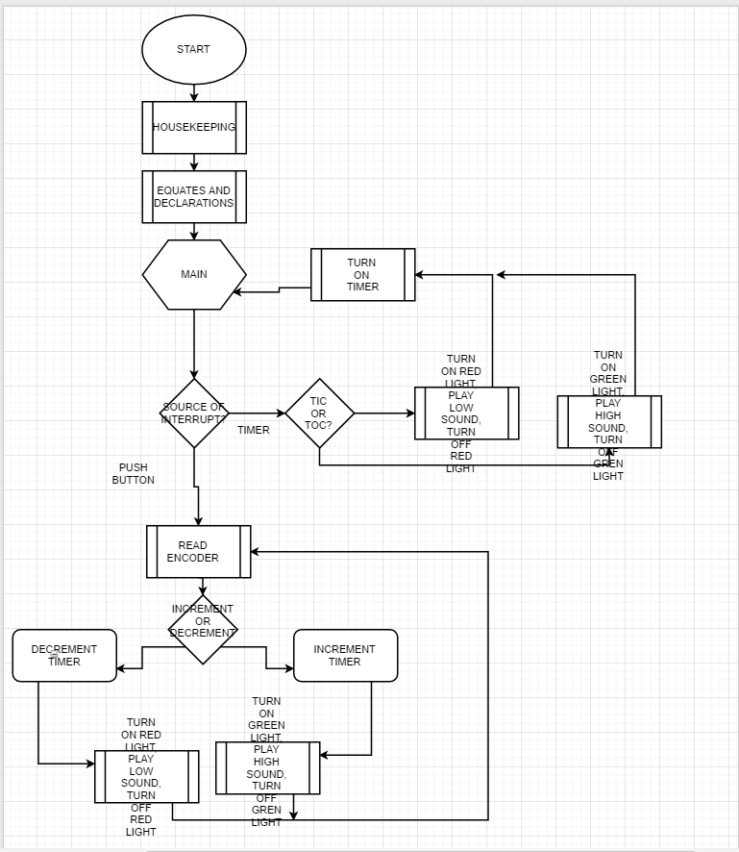
Design (program flow chart)

Slide 19

IP and prior work
Obtained literature on PIC assembly
Use a PIC microcontroller to blink a led and interrupt it with a button.

Slide 20

Testing
The test plan is focused on actuators to verify mechanicals: toggle switch functionality and toggle button functionality.

Slide 21
Test Case 01
 | Test Writer | Team#14 (Kyle Johnson, Kam Robertson, Saly Hakkoum, Brian Dunn)
 | Test case name: | Test Case 01
 | Description | Verify on/off (toggle) switch work
 | Type | Black Box
 | Tester Information
 | Name of tester
 | Hardware Version | Version 2.0
 | Setup | 1. Ohm board to verify as built assembly meets requirements for system testing. 2. Ensure board has 9V battery installed.
Step | Action | Expected Results | Pass | Fail | NA | Comment
1 | Position metronome on flat surface | Device ready for visual observation.
2 | Verify device is at initial state | Observe initial state, OFF
3 | Toggle power switch | The device changes state, visual indications such as lights turn on.
4 | Verify device is in on state | Lights turn on.
5 | Toggle power switch | The device changes state, visual indications such as lights turn off
6 | Verify device is in off state | Lights are off

Slide 22
Test Case 02
 | Test Writer | Team#14 (Kyle Johnson, Kam Robertson, Saly Hakkoum, Brian Dunn)
 | Test case name: | Test Case 02
 | Description | Verify button changes function of device
 | Type | Black Box
 | Tester Information
 | Name of tester
 | Hardware Version | Version 2.0
 | Setup | 1. Ohm board to verify as built assembly meets requirements for system testing. 2. Ensure board has 9V battery installed.
Step | Action | Expected Results | Pass | Fail | NA | Comment
1 | Position metronome on flat surface | Device ready for visual observation.
2 | Verify device is at initial state | Observe initial state, OFF
3 | Press power button | The device changes state, visual indications such as lights turn on.
4 | Verify device is in on state | Lights turn on.
5 | Press function button | Lights flash when button pressed
6 | Observe change in function | Verify function changes when button pressed

Slide 23
Results
GOOD TO GO!

Slide 24

Contributions
Kam Robertson: Project Design, Prototyping, Hardware, Software and Documentation
Kyle Johnson: Project Lead/Hybrid, focus on managing: meeting times/locations for collaboration and design review, communication, homework assignments, deadlines, presentation, project schedule, documentation (GITHUB), review hardware designs
Saly Hakkoum: Software
Brian Dunn: Software

Slide 25

Lessons Learned
Kam: EagleCAD, PCB fab shop process, Github, MPLAB_X
I gained a greater understanding of the behavior of smd components as compared to larger thru-hole devices.
Kyle: Eagle Cad, Microsoft Project, Gannt Project, Github (including command line, only method to move/rename images). Communication was difficult in the beginning (email and team collaboration).
Saly: Mainly I learned how team project works since it was my first real group project, Github, PIC microcontrollers and their assembly language, and some new experience with Eagle Cad.

Slide 26

What we would have done differently
Develop a test plan for rotary encoder functionality.
Incorporate digital display
Look for ways to utilize concurrent engineering

Slide 27
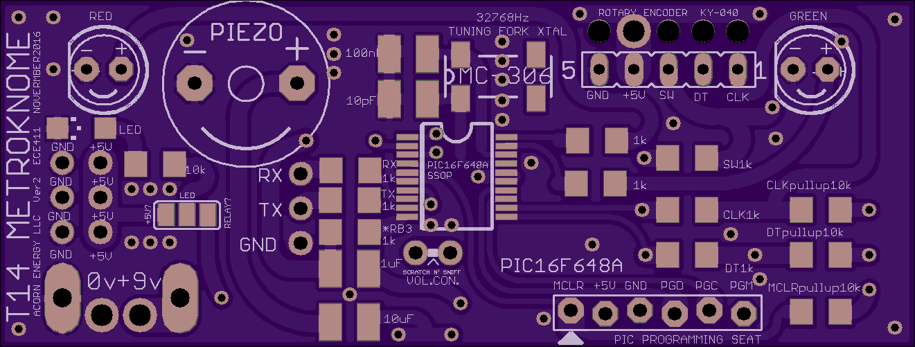
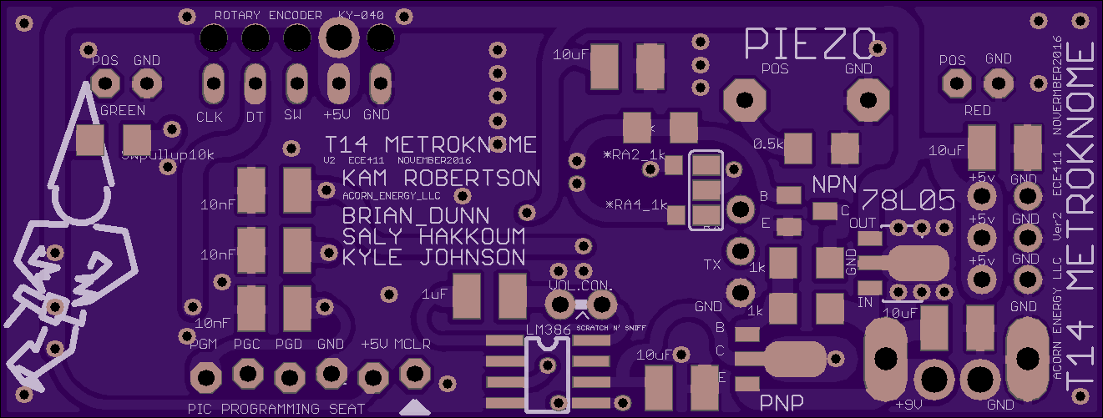
PCB V2

Slide 28
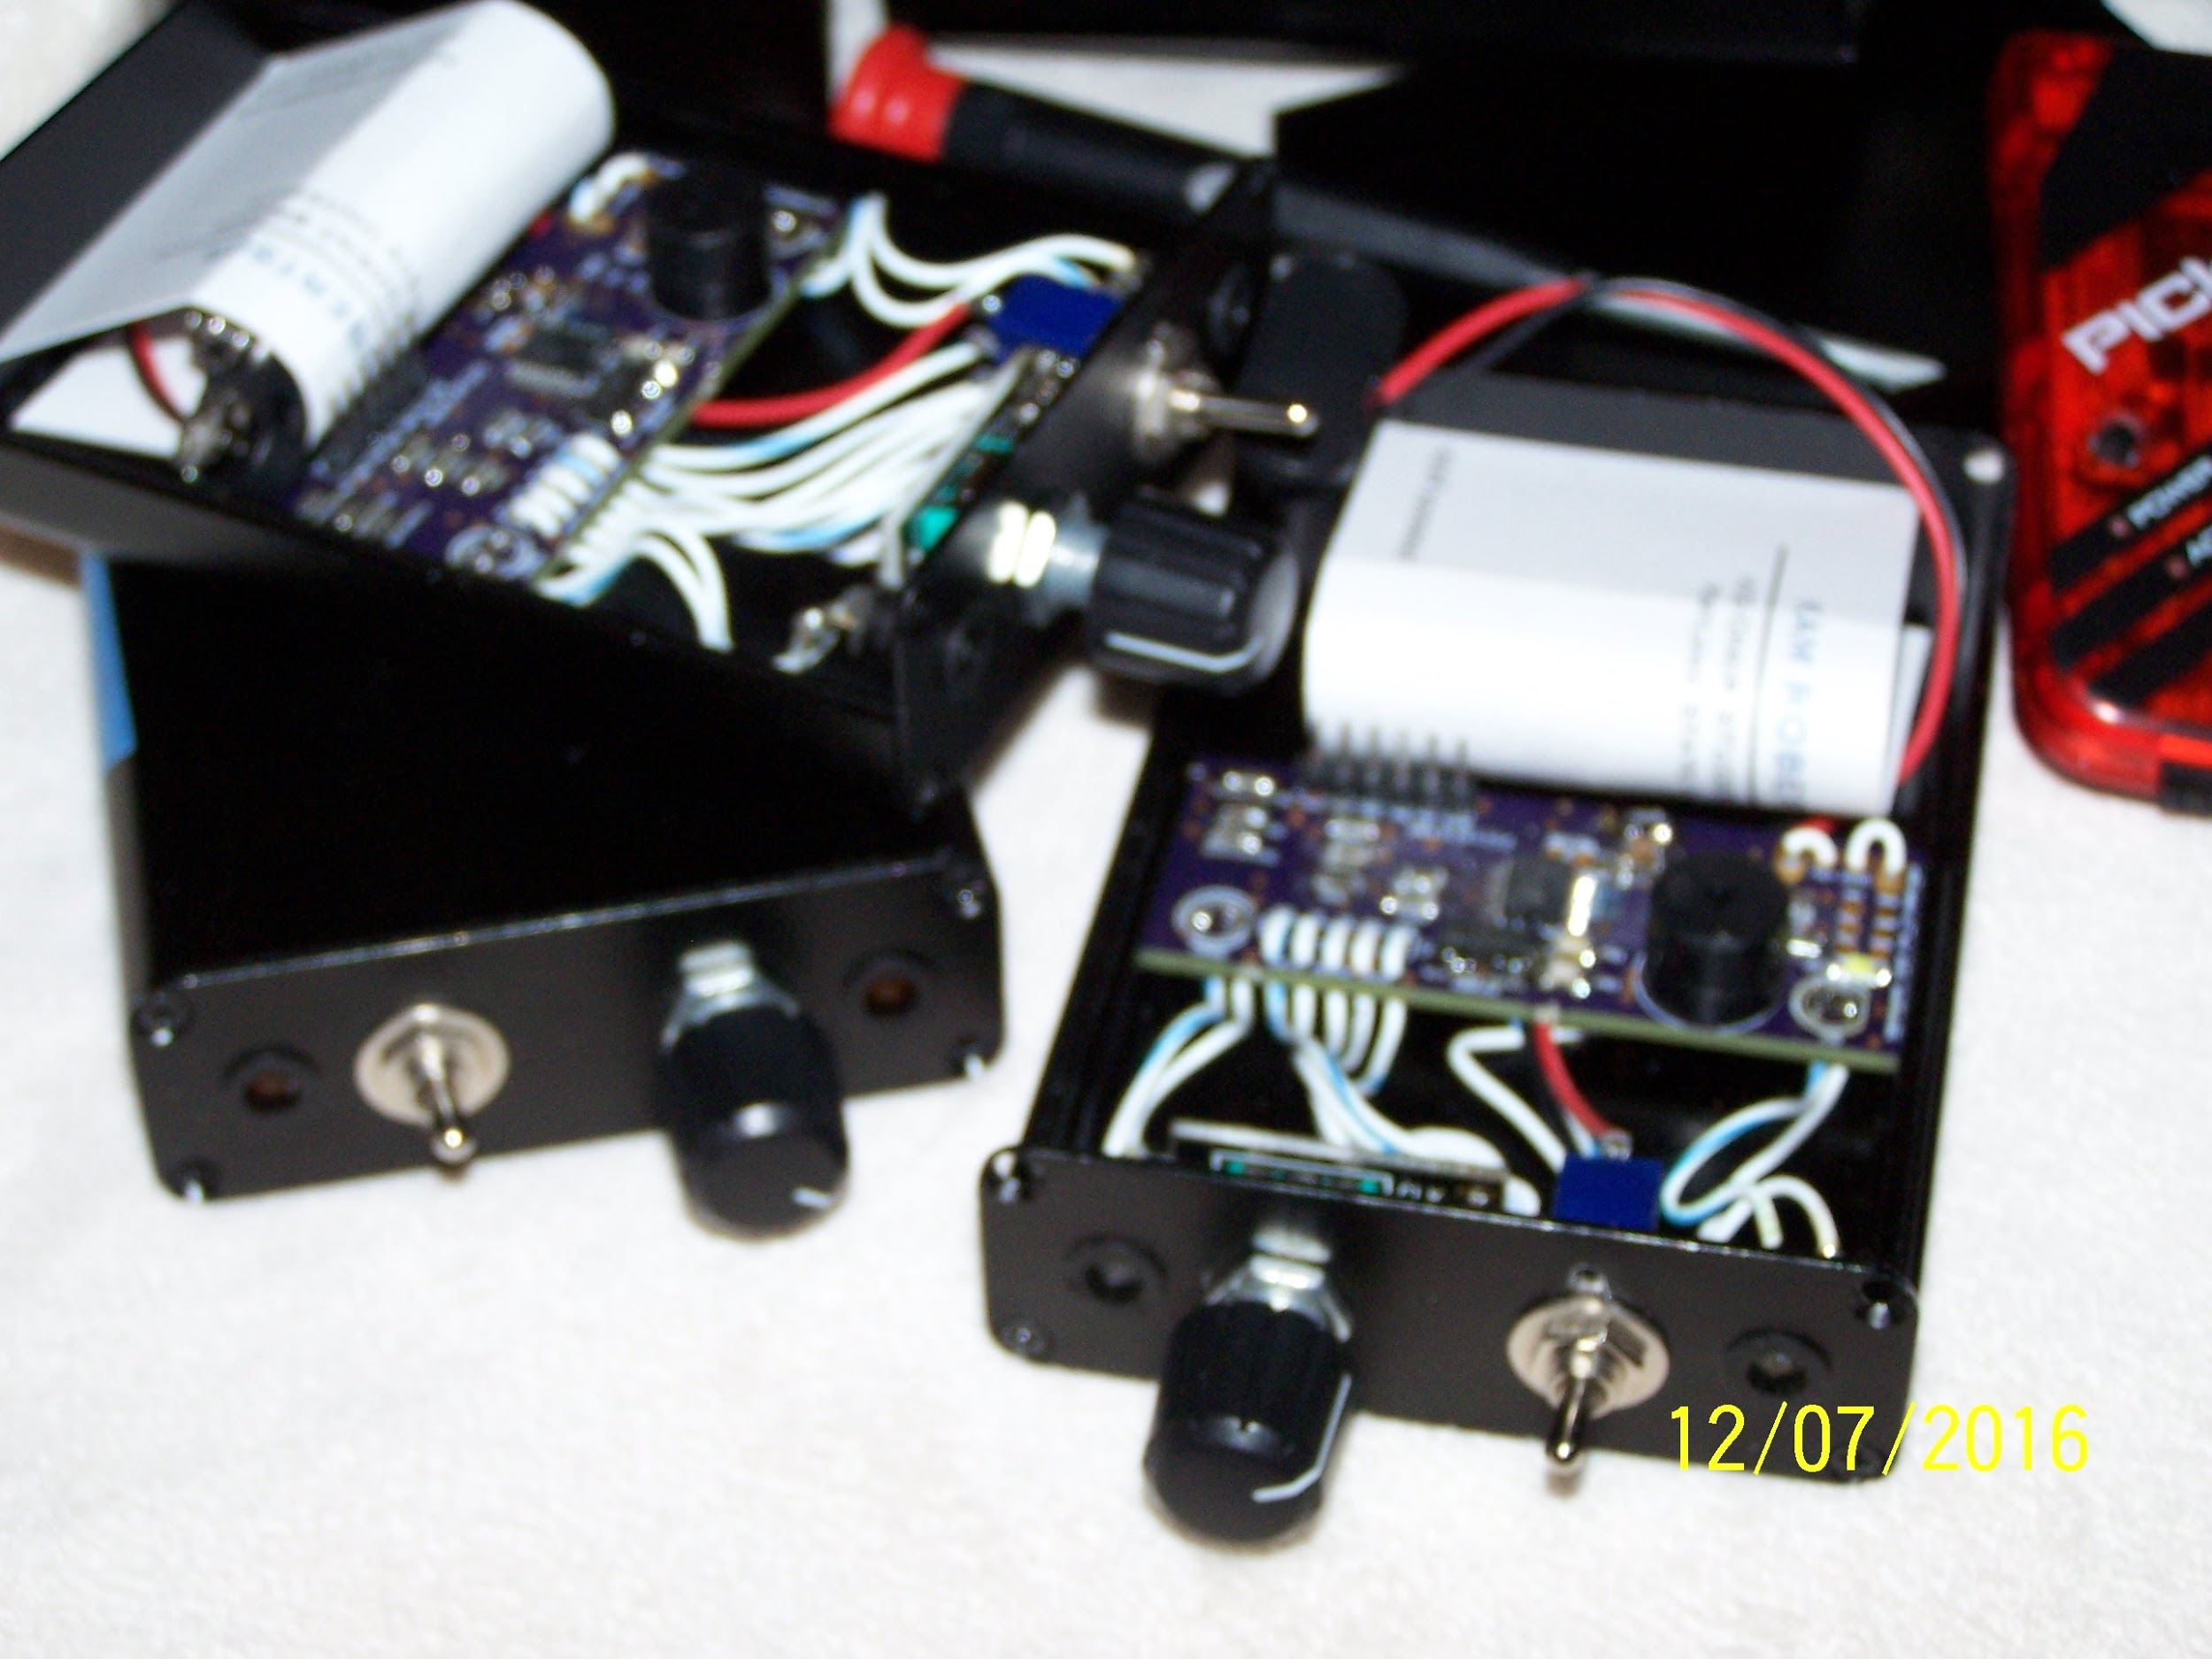
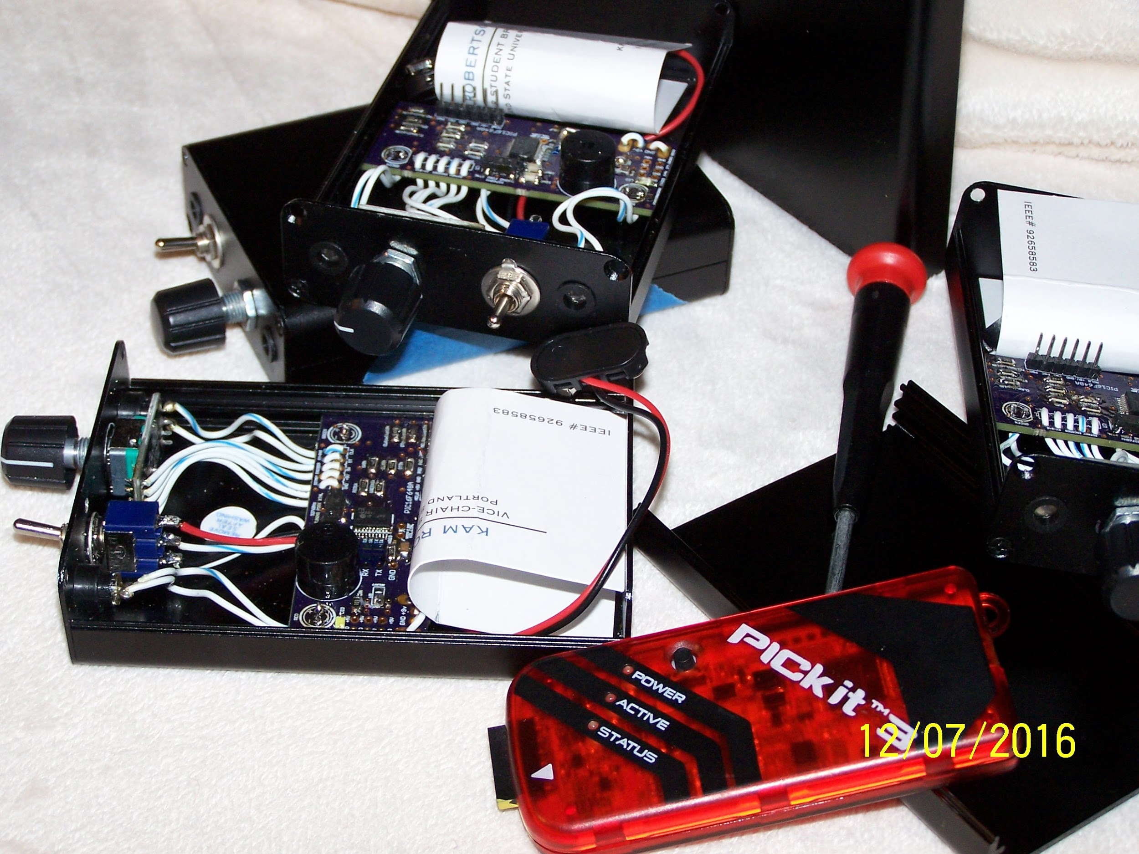
FINISHED PRODUCT

Slide 29

Questions and Answers

